Slide 1
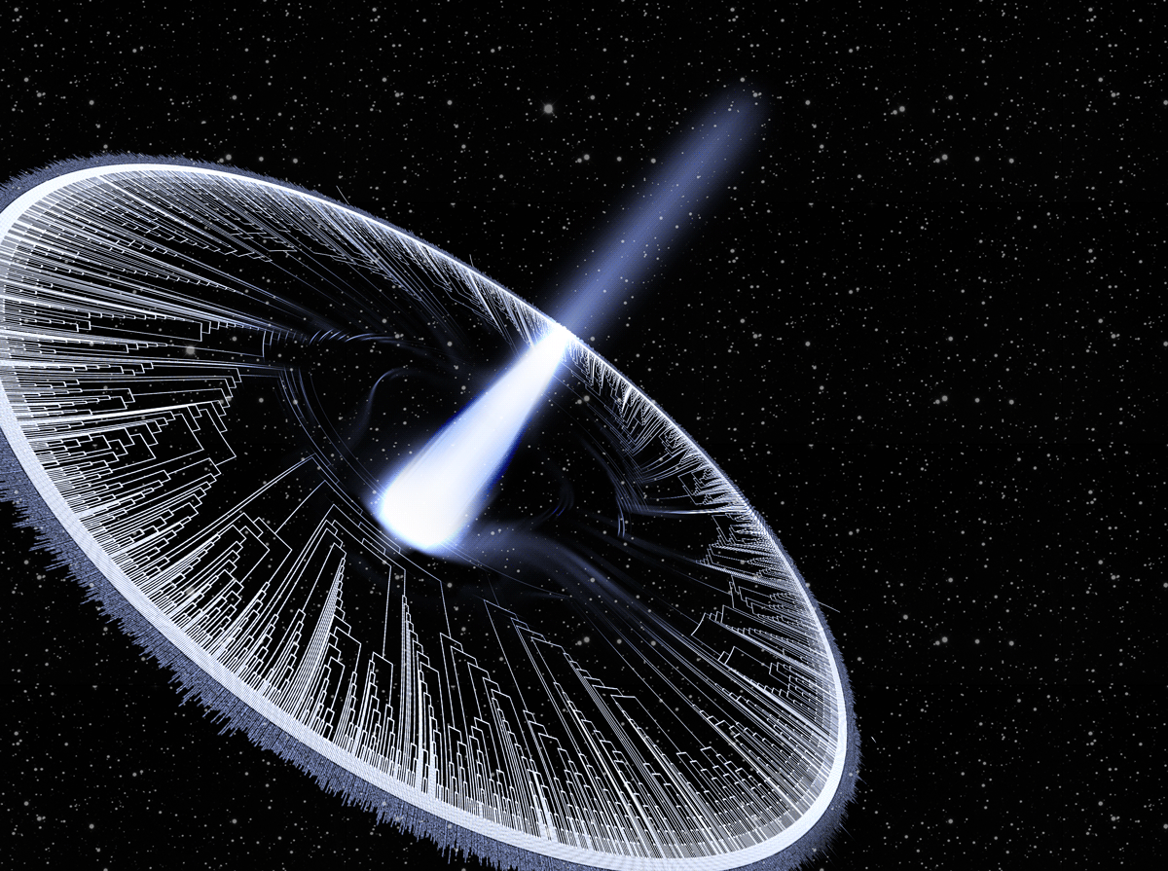
Macroevolution Instructor: Josef Uyeda juyeda@vt.edu uyedalab.com

Slide 2
Goals of the course:
1. Learn the core of phylogenetic models
2. Learn how to use trees
3. Learn about the big questions in macroevolution
4. What are your goals?

Slide 3
Syllabus - see Canvas site
*Subject to change

Slide 4
Introductions
1. Your name, department, year, program
2. A hobby or interest outside your job
3. What topic you most want to learn about in this class.

Slide 5
Why phylogeny?
What does a phylogeny represent?
www.OneZoom.org/life/
www.pollev.com/josefuyeda941

Slide 6
How many ancestors do you have?
A) Consider your personal family tree (i.e. a pedigree). How many parents do you have? How many grandparents? Great grandparents? What's the formula?
B) Use the formula in the question A above we can get our number of ancestors after say, 25 generations (25 generations for humans is ~ 400-900 years).
C) What are phylogenies? Are they a) hypotheses b) real facts that exist in nature or c) a metaphor?

Slide 7

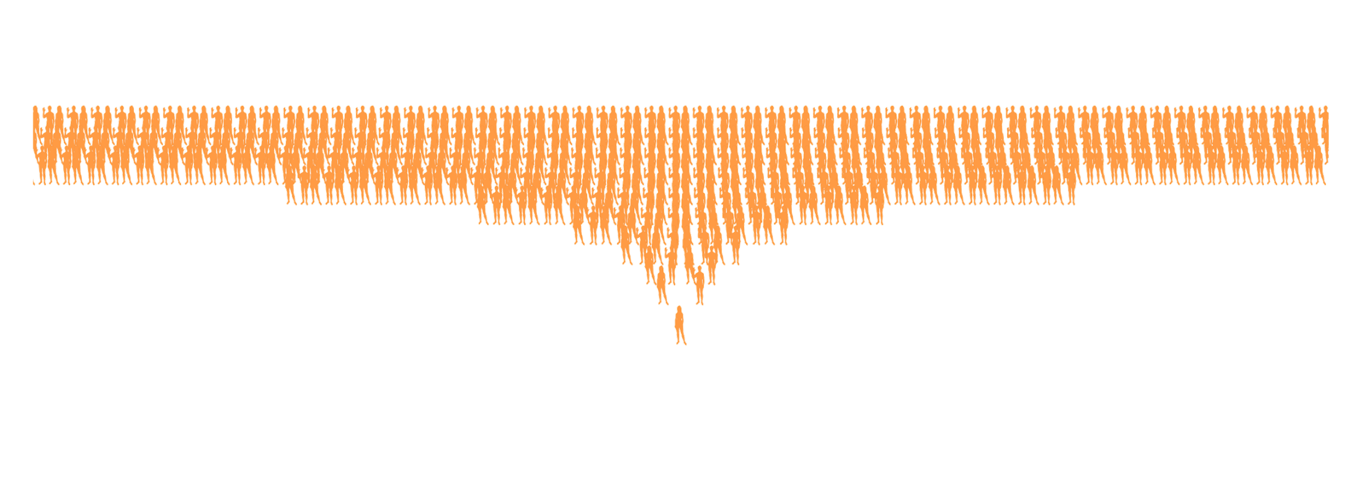
40 generations ago, you would have > 1 trillion ancestors
….2500 times the population 800 years ago

Slide 8
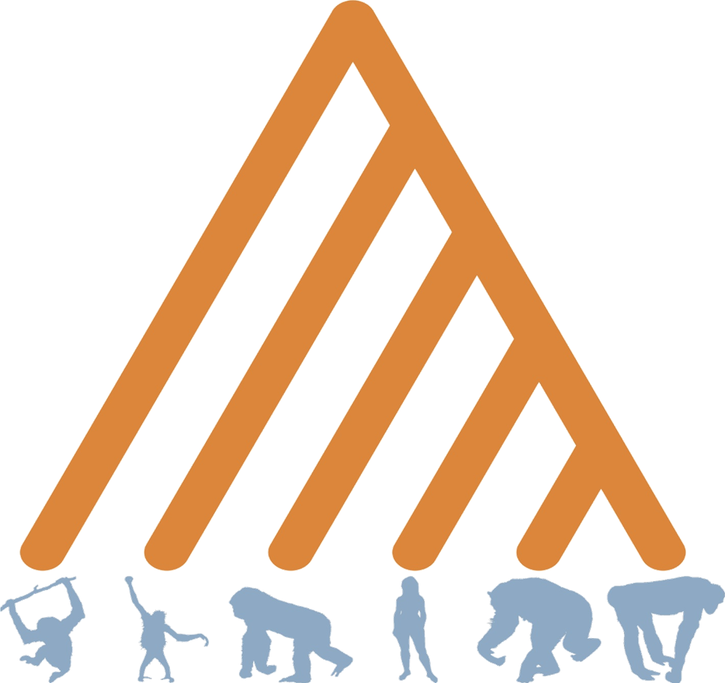

Slide 9


Slide 10
What happened here?

Slide 11
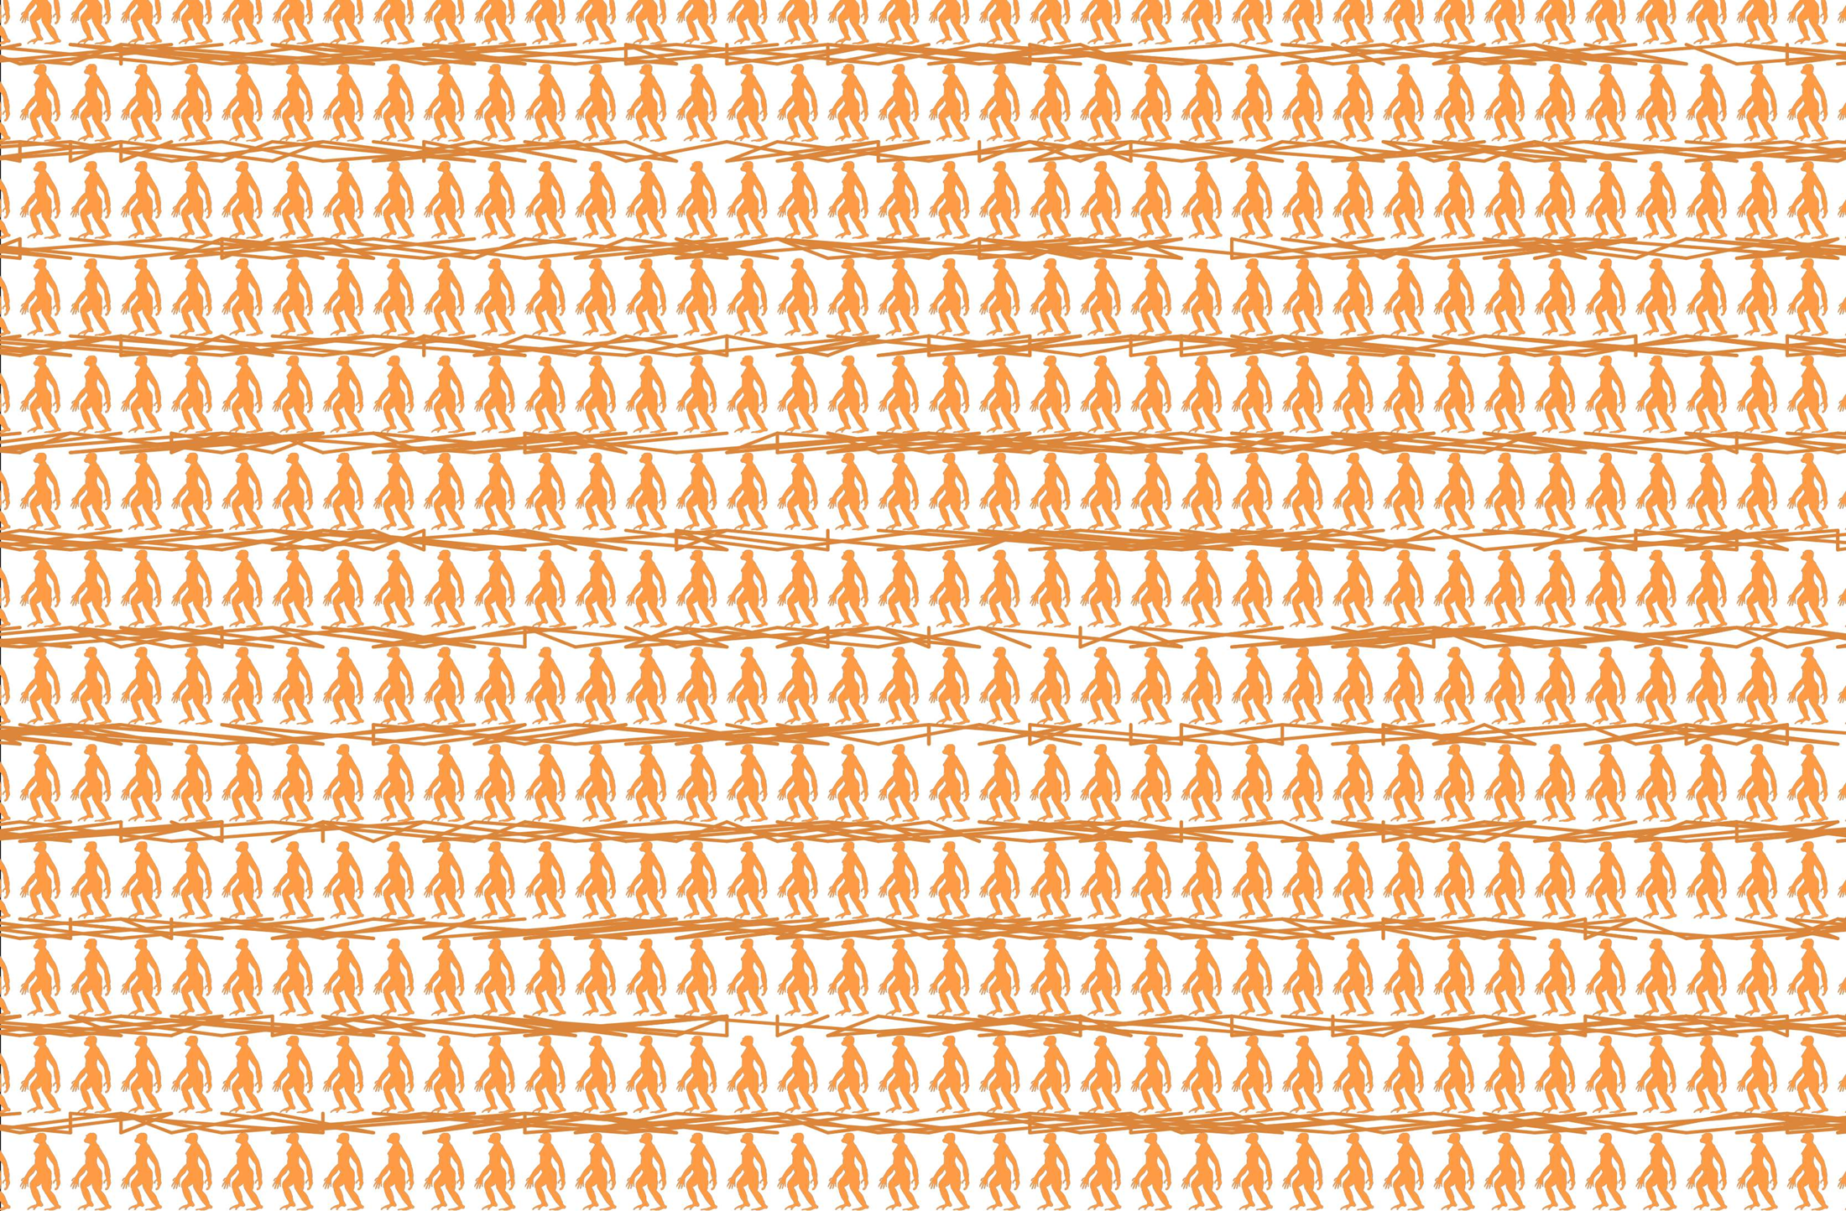
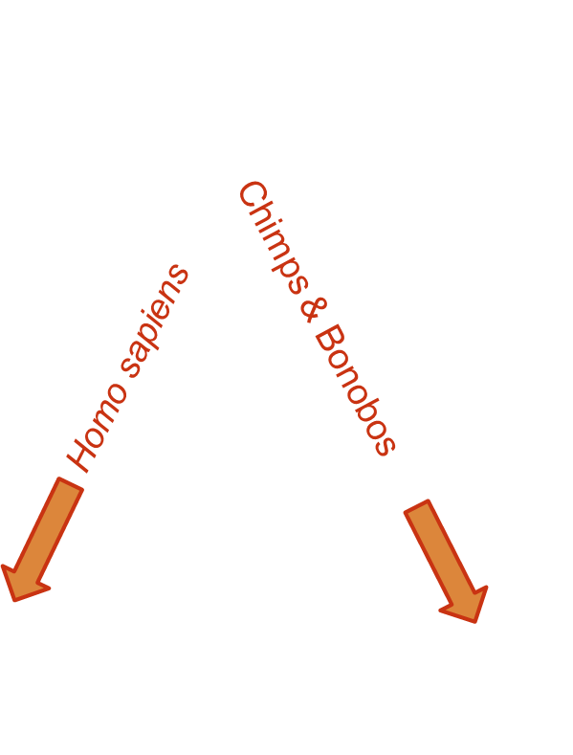
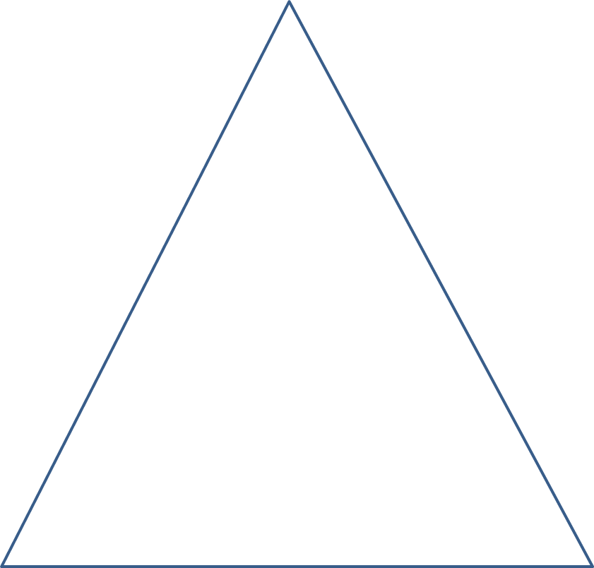
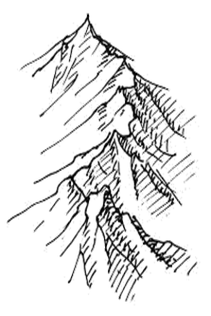
What happened here?

Slide 12
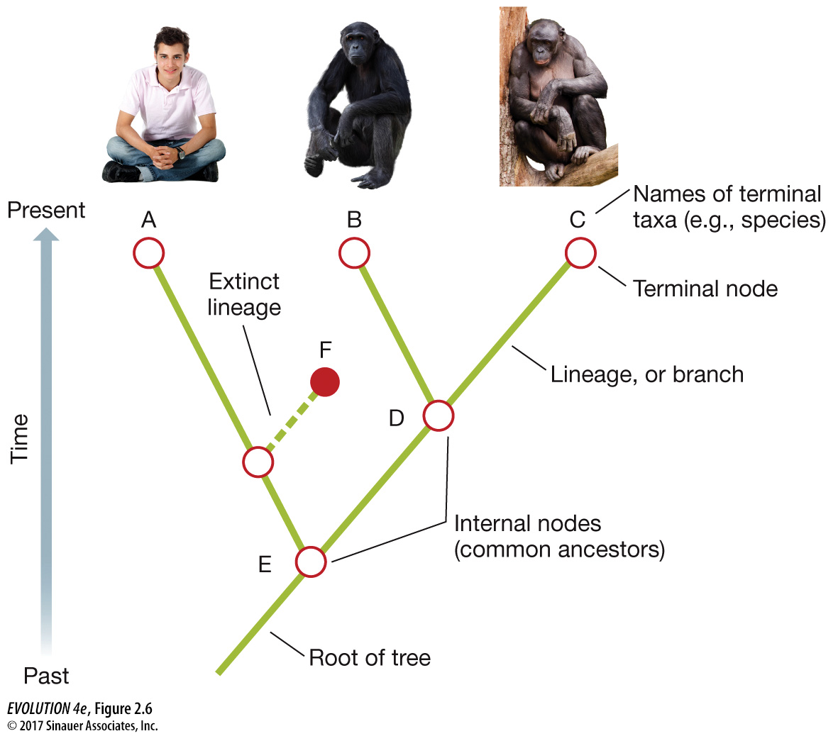
Terminology
Root Branch Node Tip Outgroup Clade Monophyletic Paraphyletic Polyphyletic

Slide 13
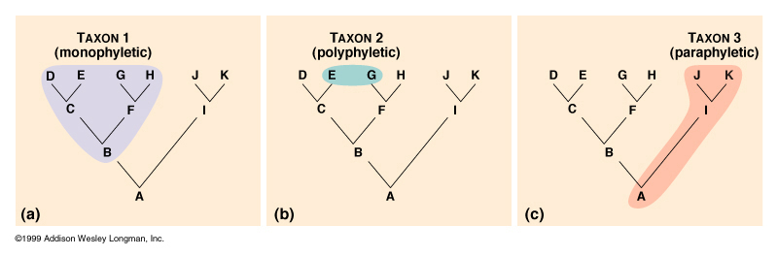
Taxonomy & Systematics Goal: Monophyly

Slide 14
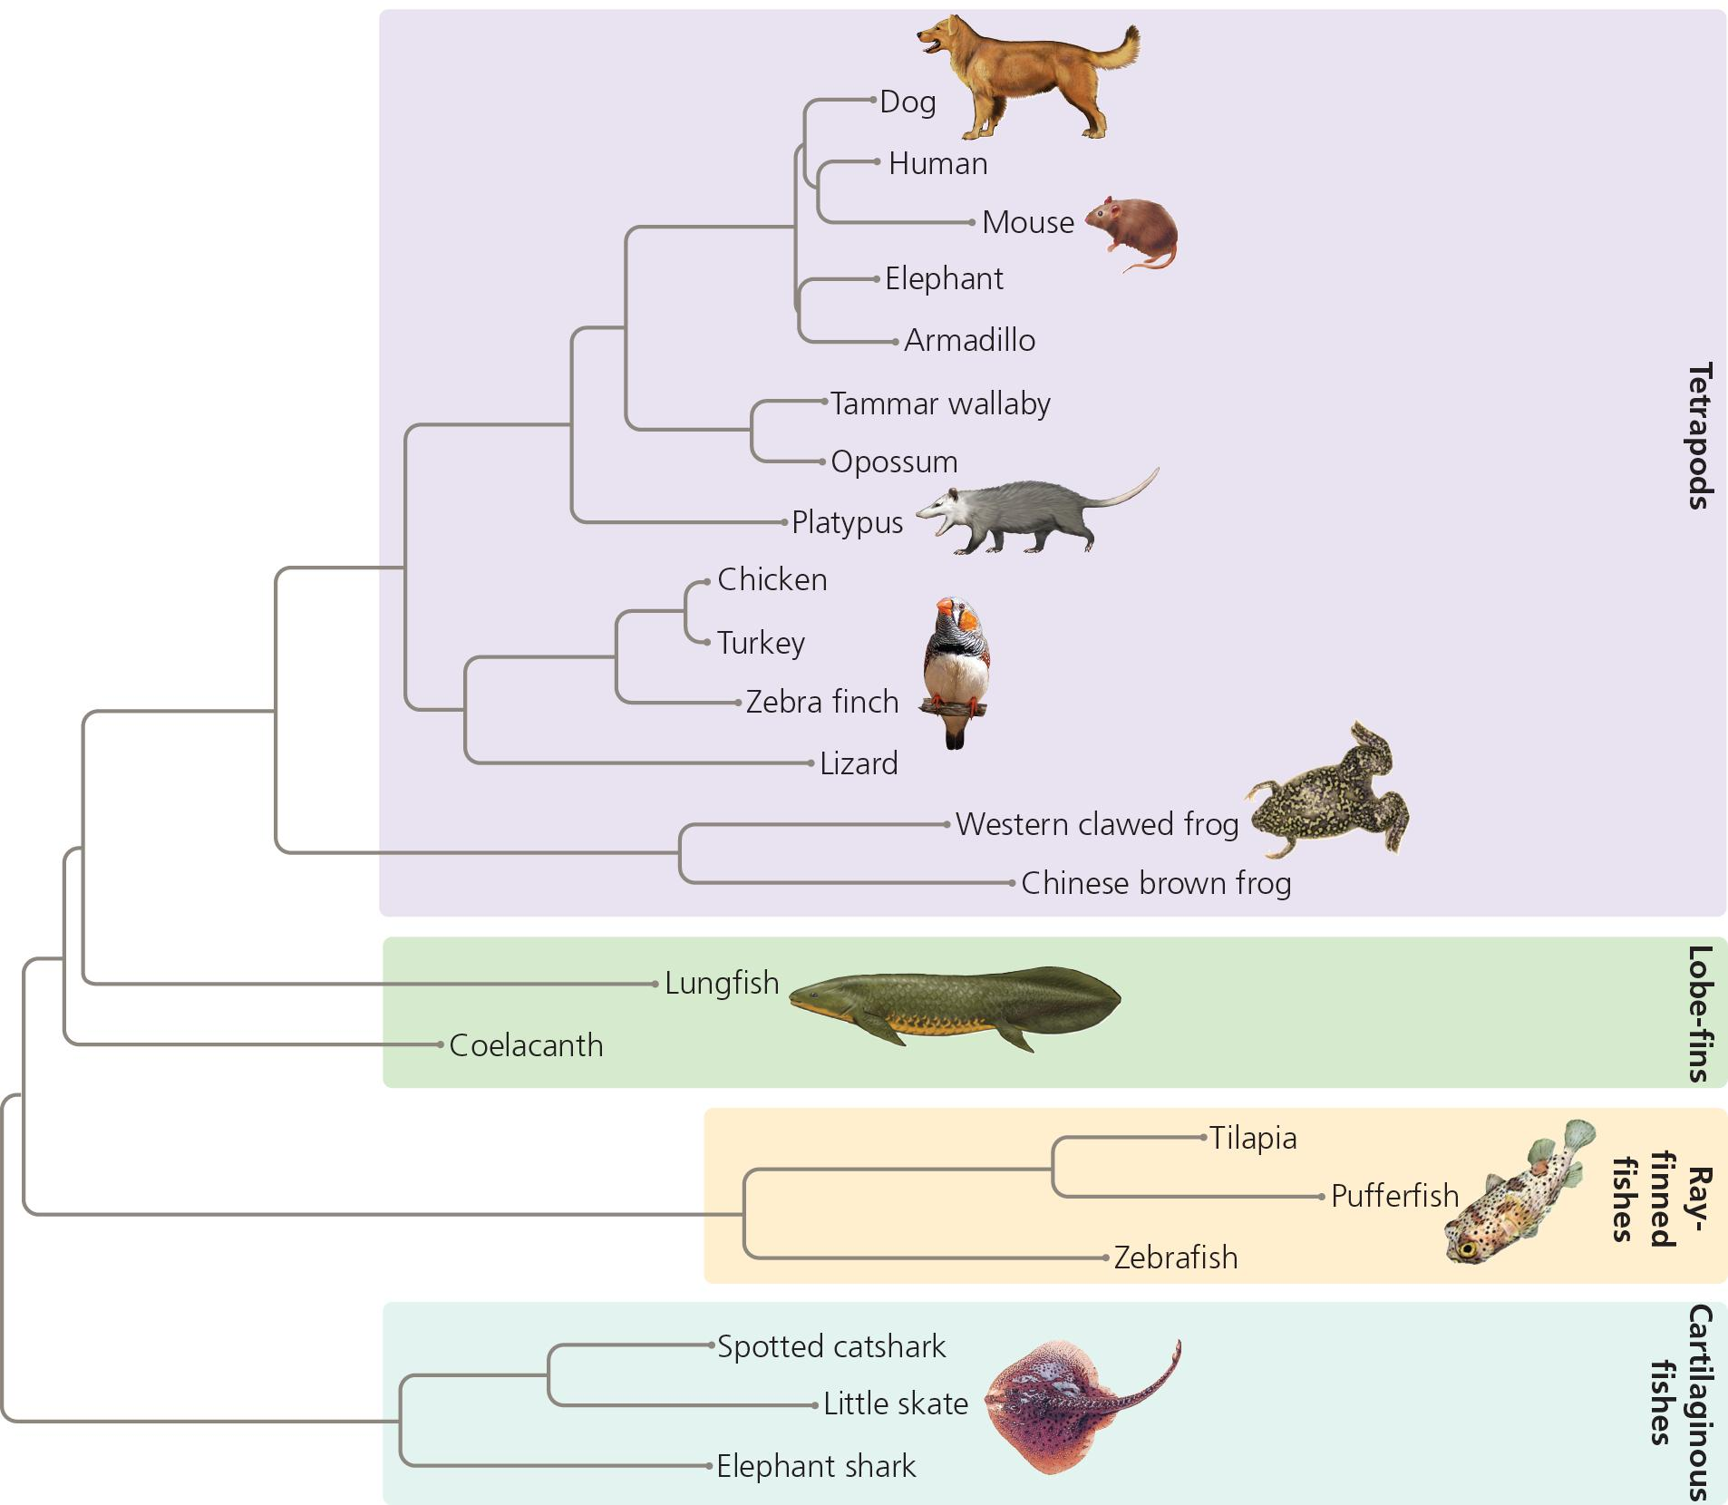
The phylogeny depicted unambiguously demonstrates that Lungfish are basal to /more primitive than frogs
True
False

Slide 15
Assignment I: Canvas self-assessment
Read Baum & Smith, and complete the questions in Assignment I. If you are registered in the class, you can take a canvas quiz (retake up to 10 times until you get 100%) to assess your understanding.
I'm going to assume you understand basic terminology and can read & interpret trees going forward.

Slide 16
Macroevolution, systematics, phylogenetics, taxonomy, biodiversity science, oh my
What is macroevolution?
We seek to understand the processes that explain biodiversity

Slide 17
My terminology
Inferring trees from data- Phylogenetics
Using trees to study evolution- Phylogenetic comparative methods
Asking questions over deep time- Macroevolution

Slide 18
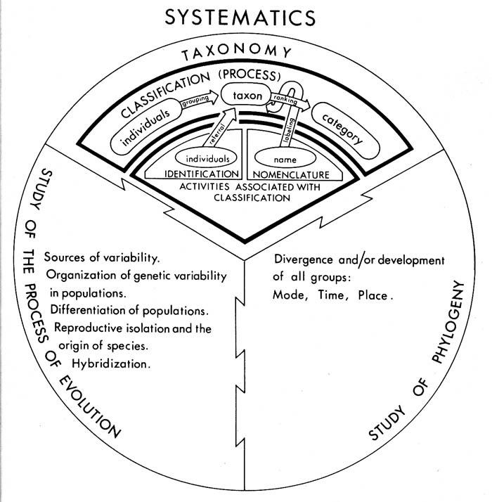

Stuessy 1990 Plant Taxonomy

Slide 19
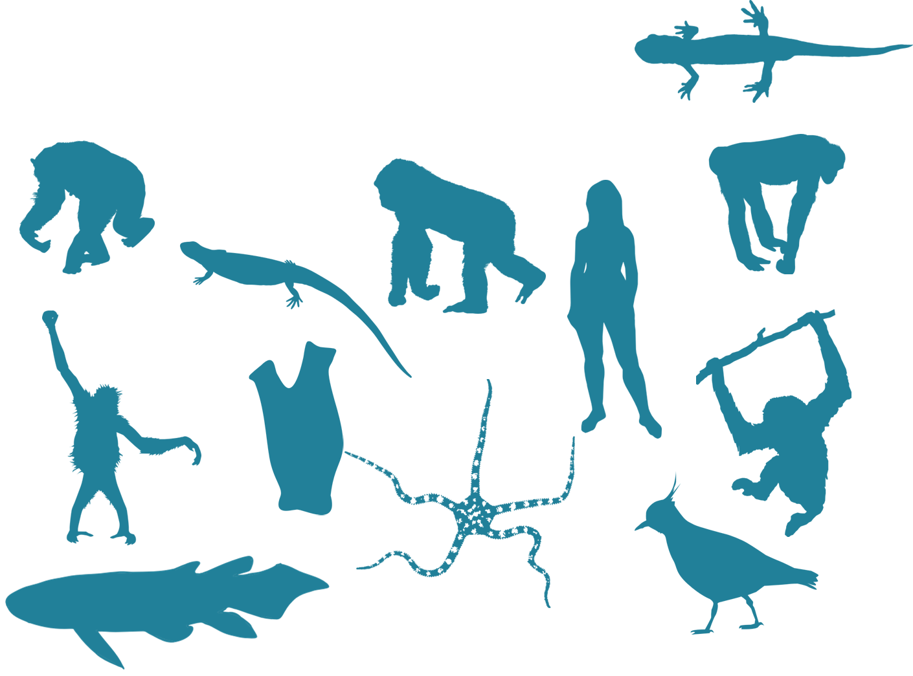
Going backwards-
Inferring phylogeny

Slide 20
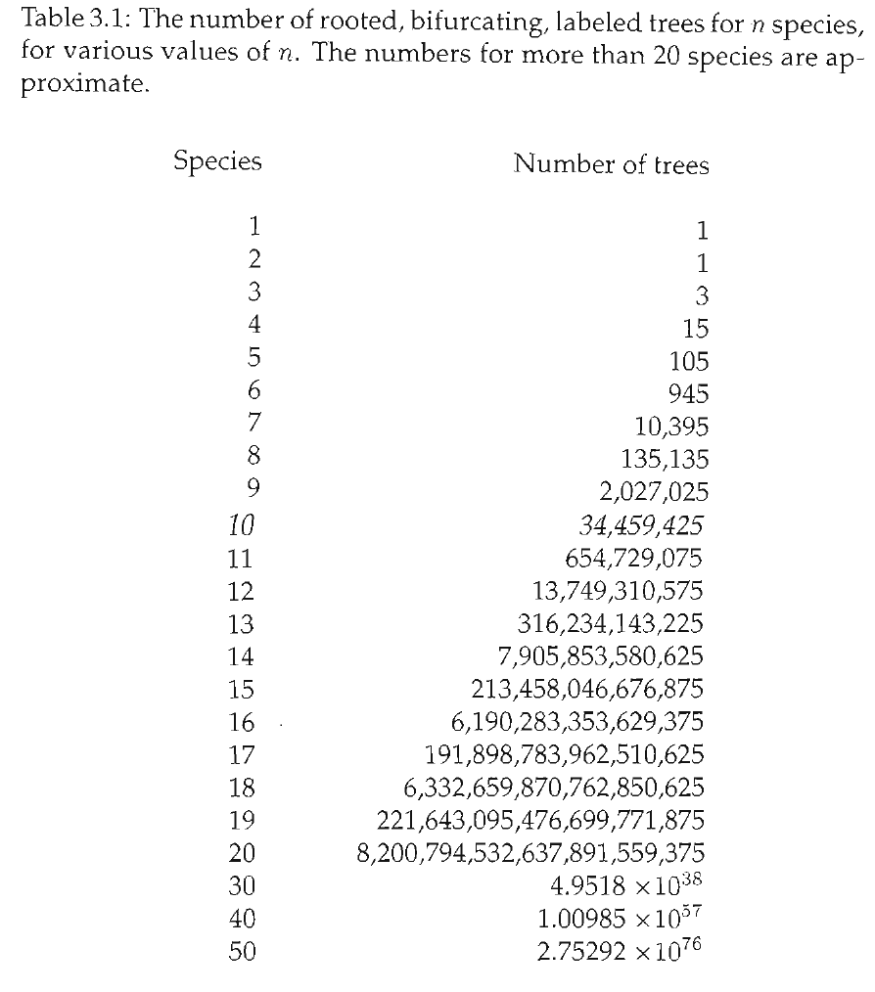
Tree space is huge!!
Inferring phylogenies is incredibly challenging statistical and computational task that has put phylogenetics at the forefront of many advances in statistics & computer science. This course will cover the story of phylogenetics and the basic models, as they are shared with phylogenetic comparative methods. However, for in depth “how-to” on building trees from molecular data, take Anton Suvorov’s course next semester!

Slide 21
How can we find the “true” tree? (Is there a true tree?!?)

Slide 22
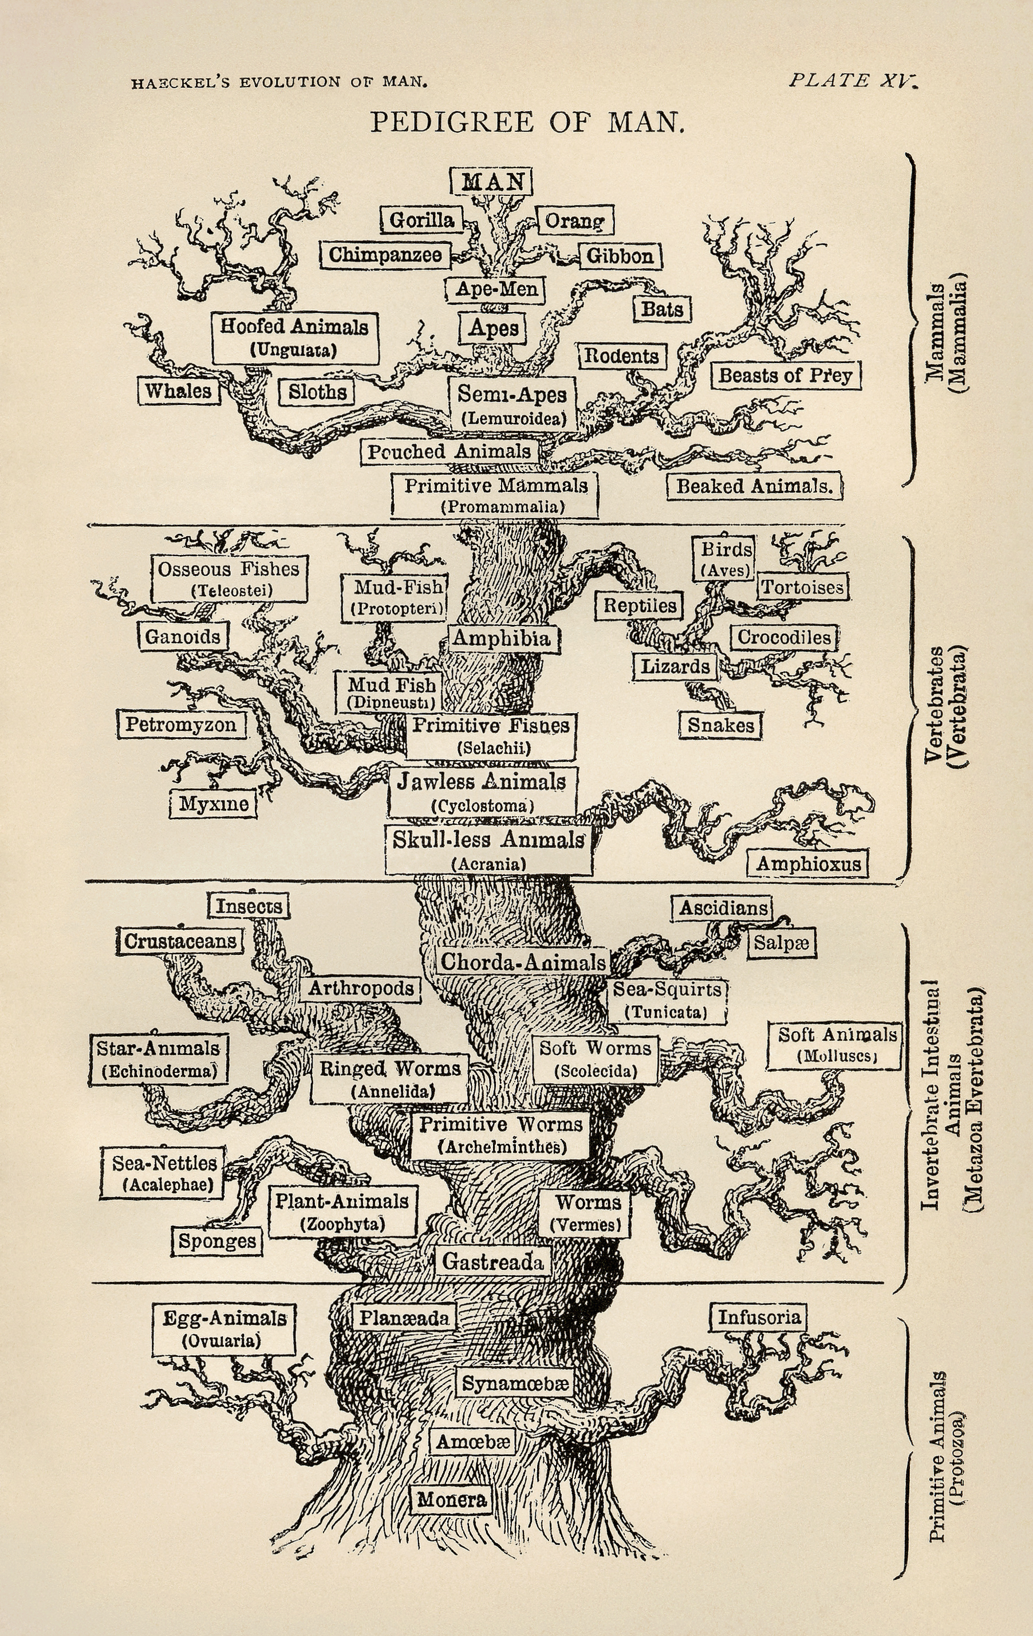
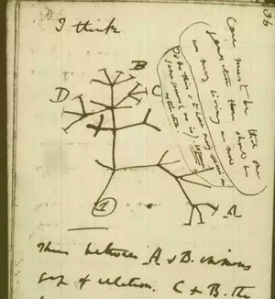
History of phylogenetics

Slide 23

History of phylogenetic inference
Evolutionary Taxonomy (Pre-1960s)
Phenetics
(1950s-70s)
Cladistics (1960s-90s)
Statistical Phylogenetics
(1970s- present)

Slide 24
History of phylogenetics: Evolutionary Taxonomy
No objective methodology
Relies on expert opinion & a lifetime of study

Slide 25
History of phylogenetics: Phenetics
Numerical Taxonomy & distance methods - measure overall similarity
How do you measure similarity?
What are the drawbacks of this approach?
Sokal, Sneath & Rohlf (1960's) argued phenetics provided much needed reproducibility

Slide 26
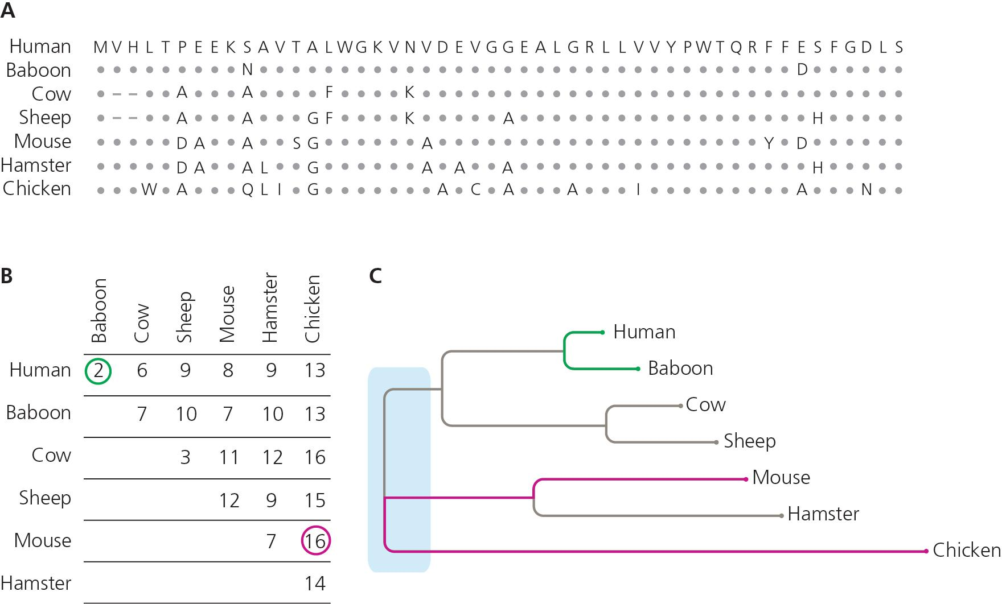

Slide 27
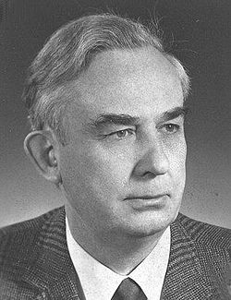
History of phylogenetics: Cladistics
"Phylogenetic systematics"
Argued that grouping should not be based on overall trait similarity, but only on shared derived traits (synapomorphies)
Taxonomy based on monophyly
Parsimony & Occam's Razor- The simplest explanation is probably the correct one
Willi Hennig (1966)

Slide 28
Phenogram
Cladogram

Slide 29
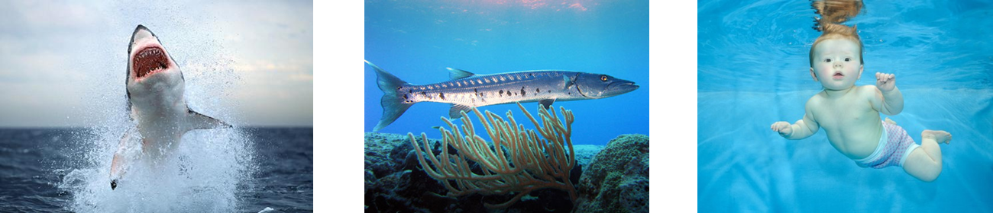
What’s the phylogenetic relationship?

Slide 30
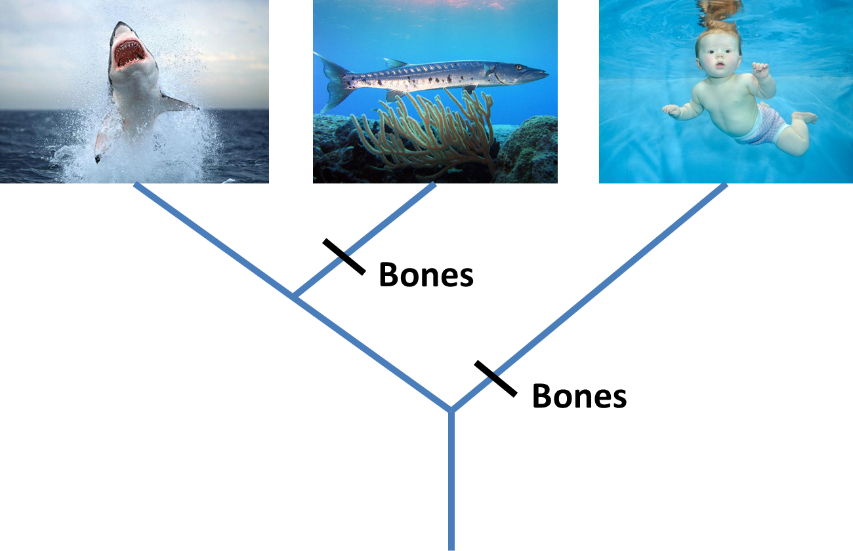

Slide 31
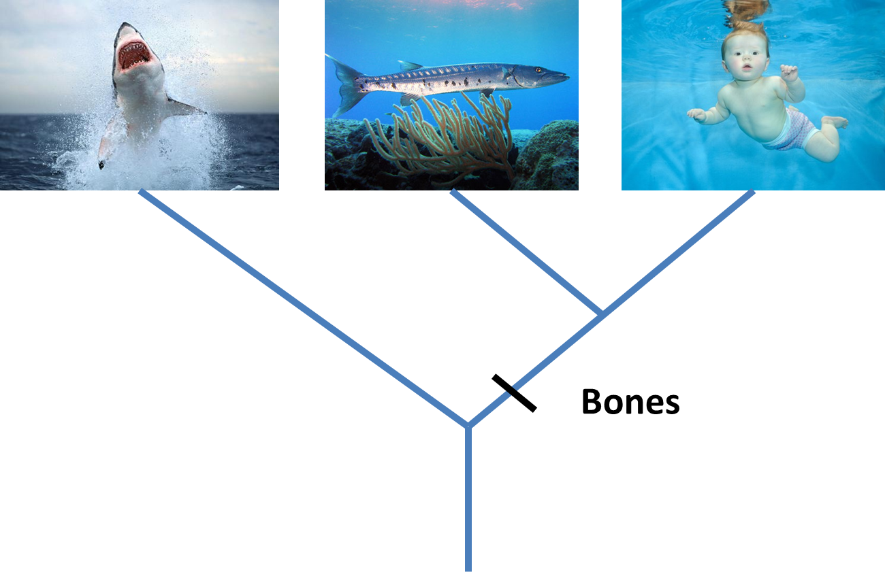
Parsimony

Slide 32
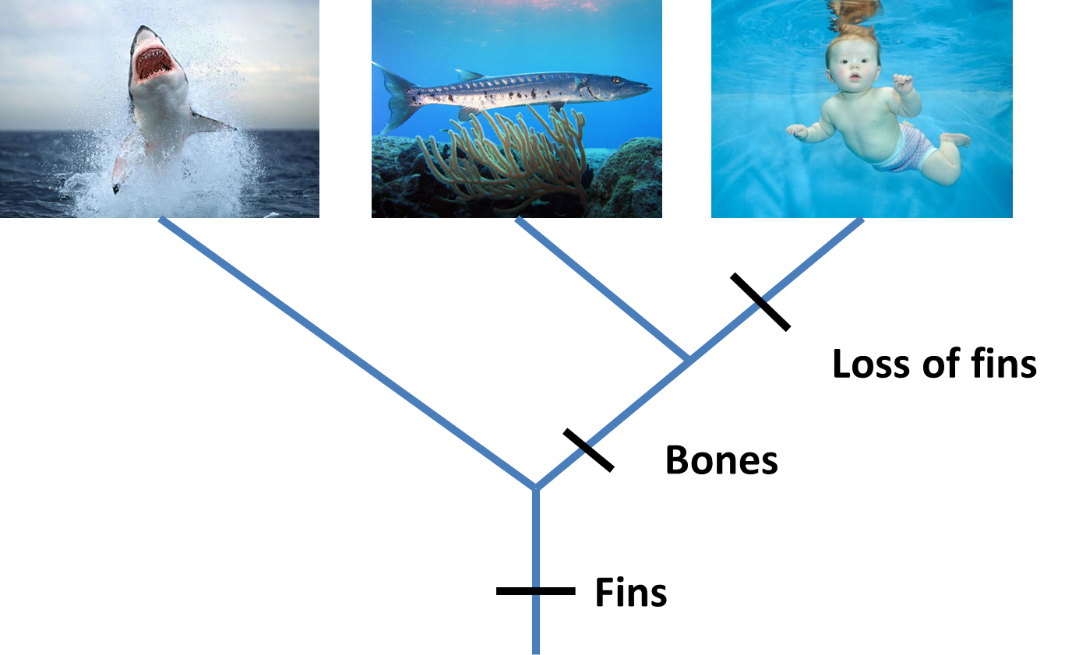

Slide 33
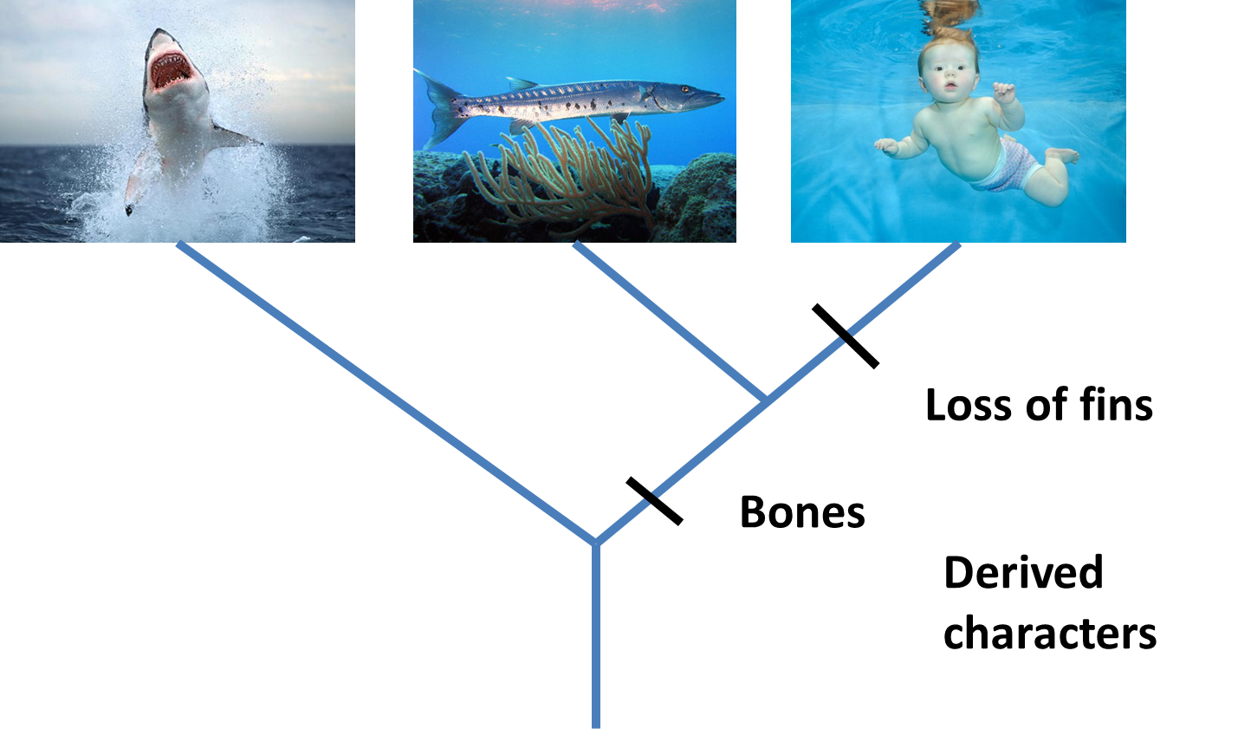
Derived Characters = Apomorphies

Slide 34
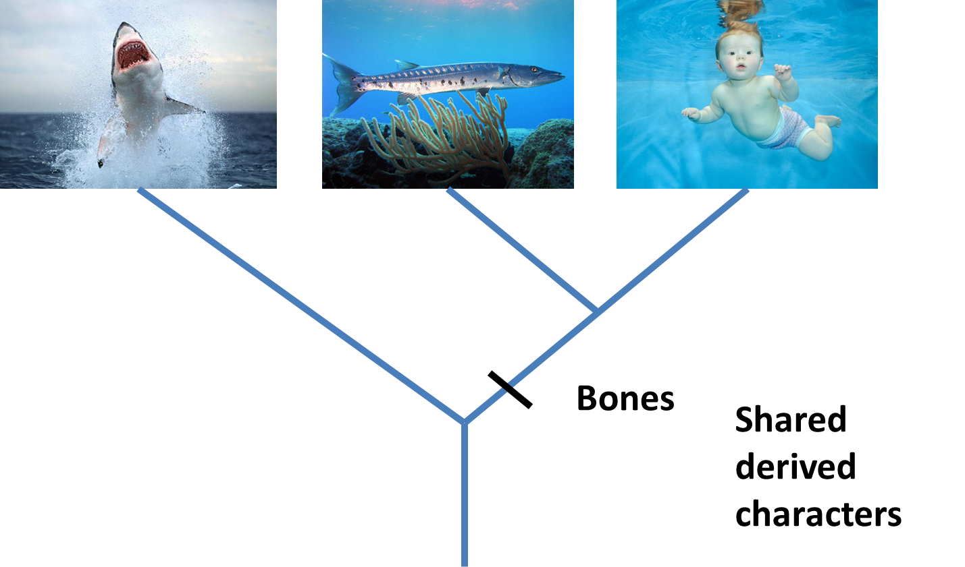
Shared derived characters = Synapomorphies

Slide 35

Shared ancestral characters = Symplesiomorphies

Slide 36
Overall similarity takes all characters equally
Cladistics only considers synapomorphies, and excludes autapomorphies & symplesiomorphies
Best supported hypothesis: Minimizing # of steps
Critical role of outgroup to distinguish derived vs. ancestral characters
Also note that characters are defined as derived/ancestral relative to the taxa being considered (the ingroup)

Slide 37
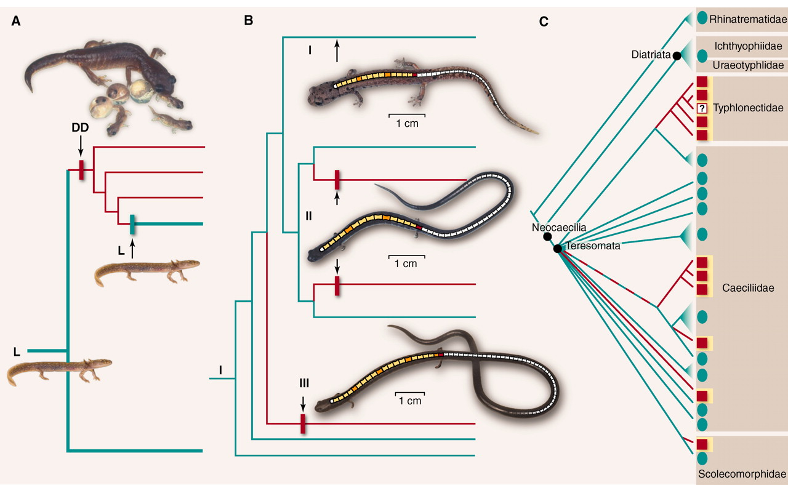
Conflict = Homoplasy Evolutionary reversals and/or convergence

Slide 38
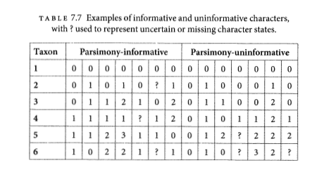
Parsimony informative vs. uninformative
Must have at least 2 taxa with shared traits in 2 different states.
Characters

Slide 39
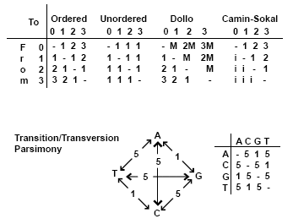
Generalized Parsimony
Step matrices
By Peter Forey https://www.palass.org/publications/newsletter/cladistics-palaeontologists/cladistics-palaeontologists-part-4-optimisation

Slide 40
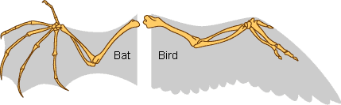
Homology
Primary homology - Initial hypothesis of homology due to similarity
Secondary homology - Implied homology single origin on phylogeny by parsimony analysis
Underlines importance of character construction - often surprisingly subjective
“Reciprocal illumination” Hennig 1966

Slide 41
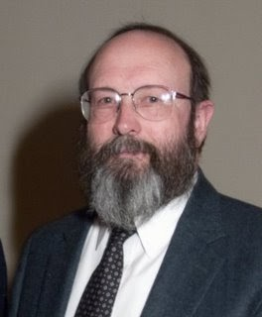
History of phylogenetic inference: Statistical phylogenetics
Luca Cavalli-Sforza, Anthony Edwards and later, Joseph Felsenstein
Probabilistic models of trait evolution
Showed statistical issues with parsimony, e.g. "the Felsenstein zone"
-> Highlighted the importance of simulation!
Maximum Likelihood & Bayesian inference
Joe Felsenstein

Slide 42
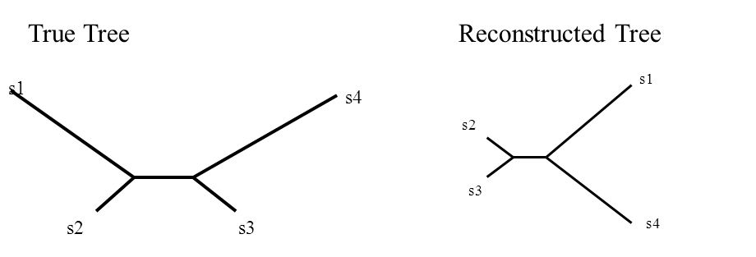
The Felsenstein Zone & "Long-branch attraction"
More generally, parsimony fell out of favor for molecular data due to more flexibility in incorporating substition models in statistical phylogenetics

Slide 43
My oversimplification of the problem...
Under the cladistics philosophy (model), homoplasy is a “mistake” in character construction
Coding independently evolved traits the same, look closer and you'll see they're different!! (e.g. wings of birds & wings of bats)
But for DNA, complete convergence is real (a “T” is a “T” is a “T”, no matter how it became that)
As similarity by convergence becomes more common than similarity by shared ancestry, parsimony fails, and no “looking closer” at the character will save it.

Slide 44
Parsimony main assumption “Occam's Razor” has unclear implications for what this means for the assumed evolutionary process Ultimately -> rare changes or "no common mechanism" (Tuffley and Steele 1997)
Inconsistent estimator - An estimator that gets more and more certain of the wrong answer as more data is added

Slide 45
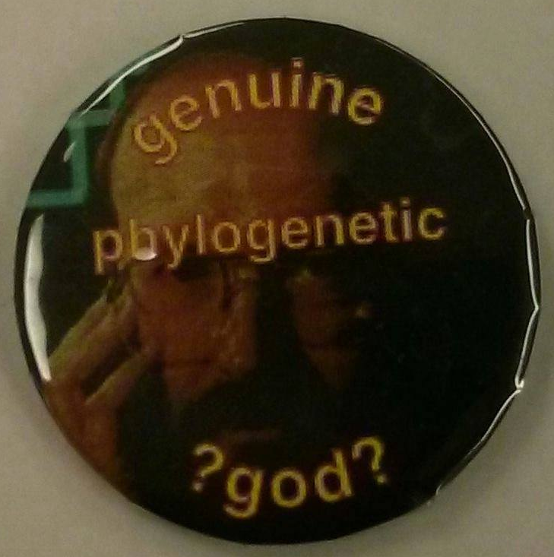
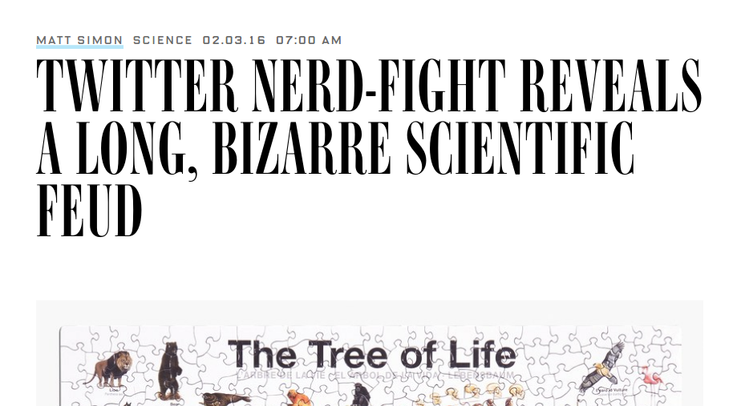
Conflict in science
#ParsimonyGate

Slide 46
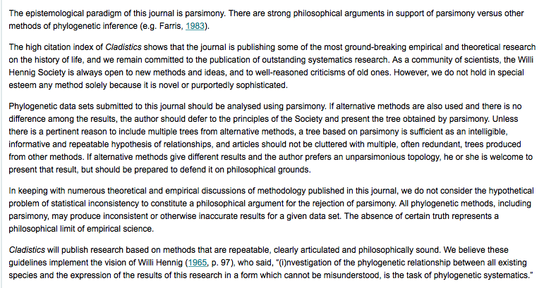

Slide 47
Parsimony still commonly used for:
Morphological analyses (though probabilistic models exist here too)
Starting trees
Understanding history of trait change (ancestral state reconstructions)

